Slide 1
The IBM pc
History of IBM personal computer

Slide 2
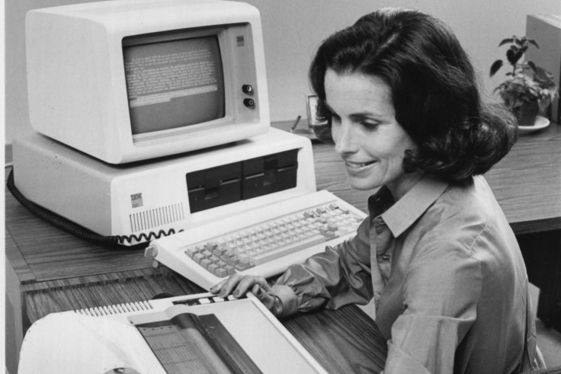
A USD 1,500 open-architecture machine became an industry standard and brought computing to the masses

Slide 3
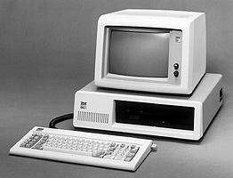
Inspiration
William Lowe pitched IBM CEO Frank Cary on the idea of a consumer PC. Cary gave him a month to develop a prototype for USD 1,500 and a year to bring it to market.

Slide 4
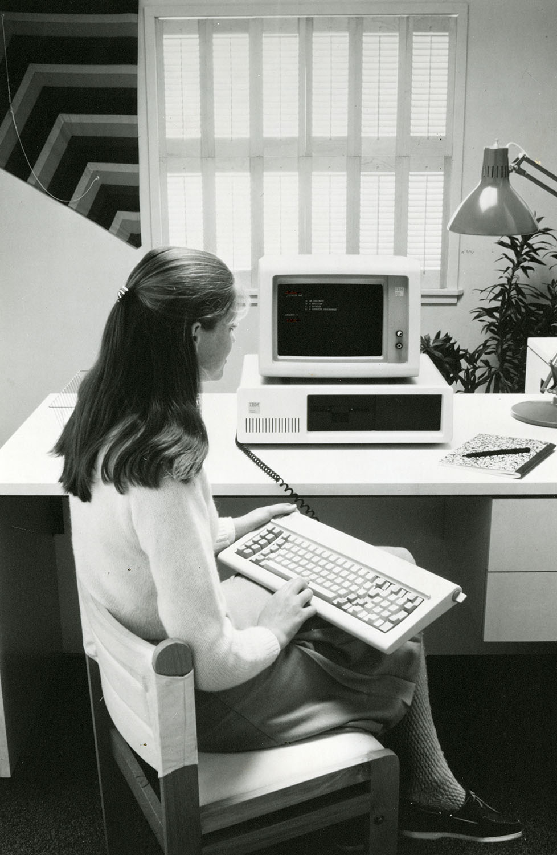
Design & sales
Despite IBM’s history of designing and building everything it sold, the team decided the only way to hit the deadline was to use off-the-shelf parts

Slide 5
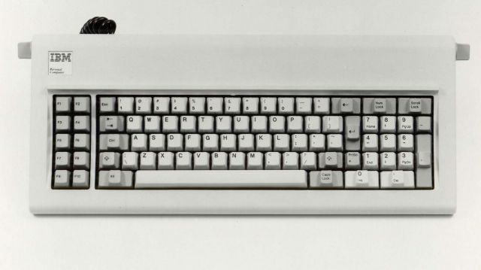
Specifications
Intel 8088, 4.77mhz
16mb-64mb
CGA video – 640x200
Five 8-bit ISA slots
83 key keyboard
PC-DOS 1.0 by Microsoft
One or two single-sided 180kb floppy drives

Slide 6
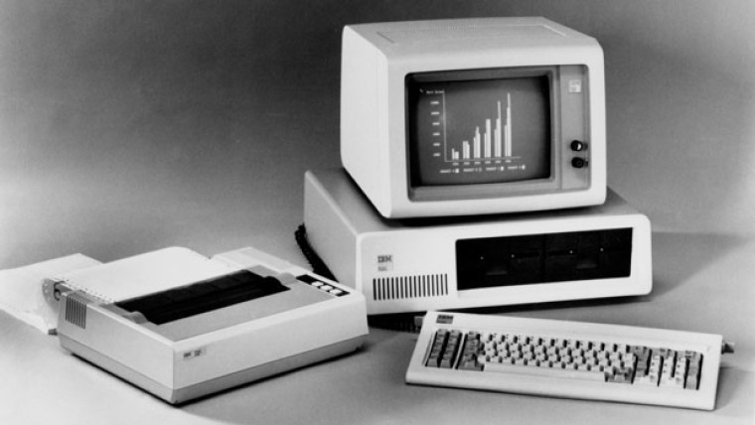
Market reaction
Time called the PC its ‘Machine of the Year.’ Newsweek called it ‘IBM’s roaring success.’

Slide 7
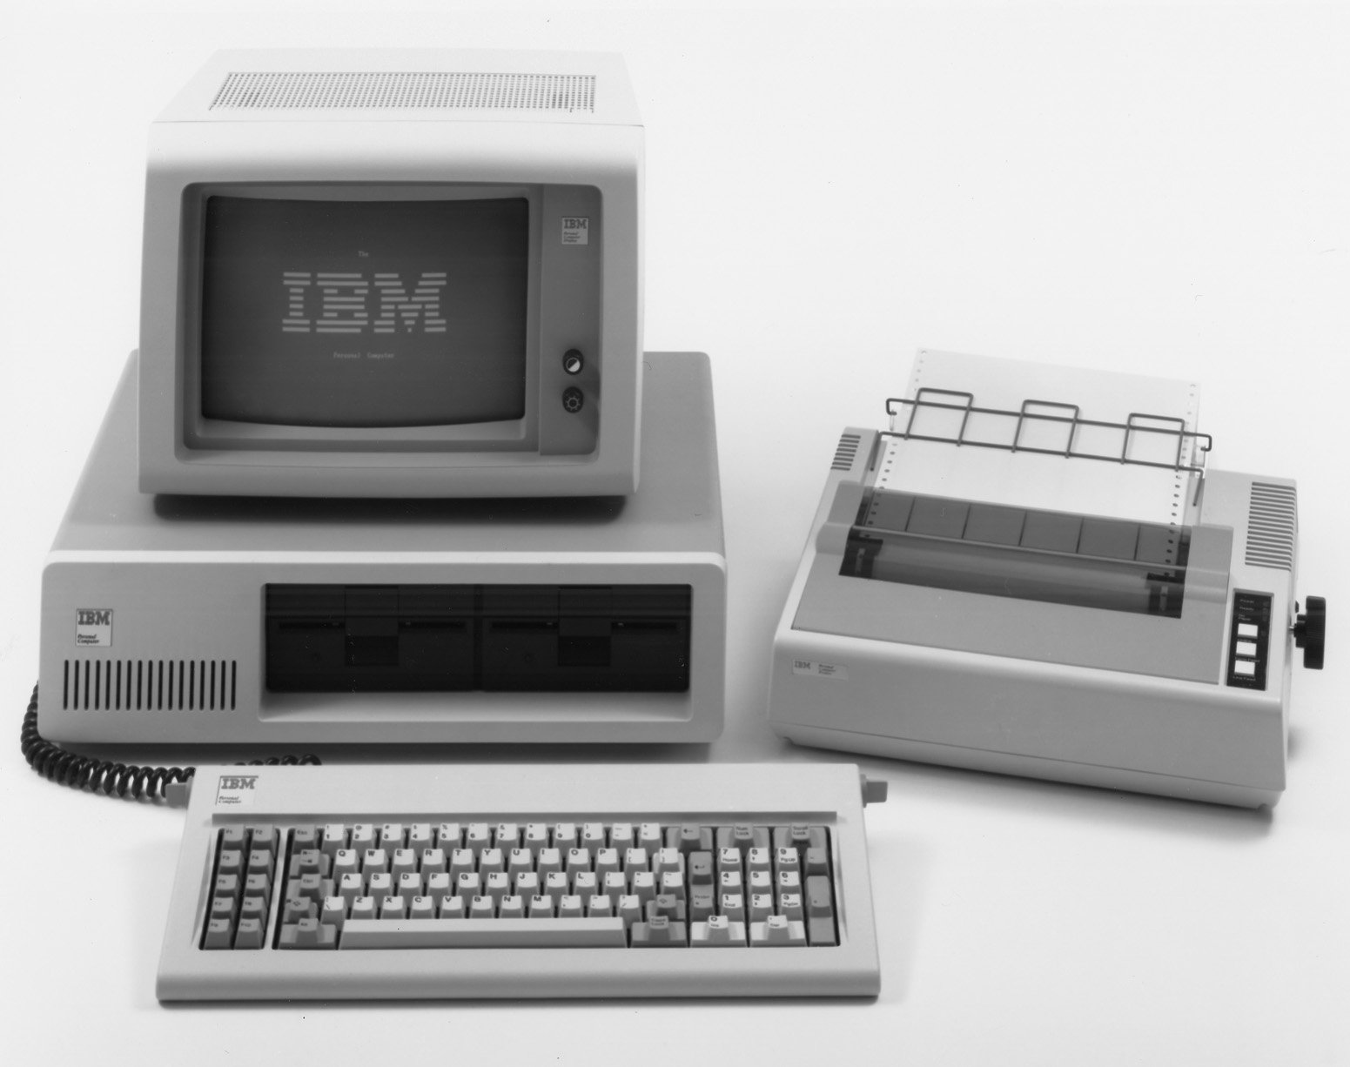
Thank you for your attention

